Slide 1
AutoML Framework and Tools
Automated machine learning for faster, smarter model building

Slide 2
Contents
01
02
What is AutoML?
What is H2O?
03
04
Data Handling/Pre-Processing in H2O
Key Parameters in H2O
05
06
Understanding the Leaderboard
Explaining Model Output

Slide 3
What is AutoML? ( Recap)
Automated ML
Automatically trains multiple model without manual intervention
Hyperparameter Tuning
Optimizes model parameters automatically
Best Model Selection
Selects top performer based on specific metrics in
classification or regression problem.
Reduced Effort
Eliminates manual trial-and-error. Highly efficient
when large number of model are required to be trained.

Slide 4
AutoML in Python: Library Overview
H2O AutoML
Enterprise-grade AutoML with strong performance and scalability
auto-sklearn
Built on scikit-learn with Bayesian optimization and meta-learning
PyCaret
Low-code ML library with simple API and extensive preprocessing
TPOT
Uses genetic programming to optimize ML pipelines
These libraries differ in automation level, flexibility, and computational requirements.

Slide 5
What is H2O?
Platform Overview
H2O is an open-source machine learning platform built for speed and scalability. It runs on its own Java engine and works seamlessly with Python and R.
H2O includes automated machine learning (AutoML), model interpretability tools, and support for advanced algorithms like GBM, Random Forest, Deep Learning, and XGBoost.
Key Strengths
It provides distributed in-memory processing, allowing you to train models efficiently on large datasets.
It scales horizontally across clusters, making it suitable for enterprise-level big data applications.
Its integration with Python, R, and Spark enables seamless deployment within existing data science workflows.

Slide 6
H2O vs Traditional Modeling
Traditional ML
Manual algorithm selection
Manual hyperparameter tuning
Separate preprocessing steps
Time-consuming process
H2O AutoML
Automatic algorithm selection
Automatic tuning
Built-in data preprocessing support
Faster experimentation

Slide 7
Data Handling Prior to AutoML in H2O
1. Convert to H2OFrame
Data must be converted to H2O's native format
2. Convert Categoricals
Use .asfactor() for categorical variables
3. Split Data
Train-test split using split_frame()
4. Set Target Type
Target datatype determines classification vs regression

Slide 8
H2O’s Automation Power
H2O Handles Internally
Missing value handling
Encoding categorical variables
Feature scaling (when required)
Cross-validation
Metric evaluation
Hyperparameter search
User Controls
Target column selection
Feature list definition
Data types (numeric vs factor)

Slide 9
What is H2OAutoML() Function?
The main function that automates the entire model building process
Trains Models
Multiple families: GBM, RF, XGBoost, GLM
Tunes Parameters
Optimizes hyperparameters automatically
Ranks Models
Orders by performance metrics
Builds Ensembles
Creates combined models
Returns Best
Delivers top performer

Slide 10
Key Parameters in H2OAutoML
max_models
Maximum number of models to train; controls the search space and limits total training time.
max_runtime_secs
Maximum time (in seconds) allowed for training; stops the process once the time limit is reached.
seed
Sets a fixed random state to ensure reproducible and consistent results.
balance_classes
Optional parameter to handle imbalanced datasets by automatically adjusting class distribution during training.

Slide 11
Single Model vs Ensemble Model
Single Model
Examples: GBM, Random Forest, XGBoost
H2O AutoML can select a single best-performing algorithm as the leader.
The final model may be an individual algorithm instead of an ensemble, based purely on validation performance.
Ensemble Model
Types:
StackedEnsemble_BestOfFamily
StackedEnsemble_AllModels
Appears when sufficient runtime and multiple base models are available.
Selected as the leader when the stacked ensemble outperforms all individual models on validation metrics.

Slide 12
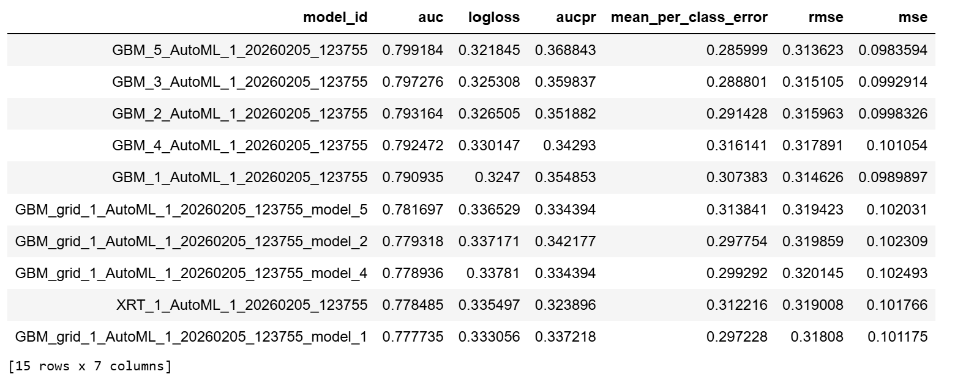
Understanding the Leaderboard
Ranked Table
All trained models ranked by default metric (e.g., AUC for binary classification)
Top Row = Best
The highest-performing model appears first
Model Type
Can be single model or ensemble
Metrics Displayed
AUC, LogLoss, RMSE, and more

Slide 13
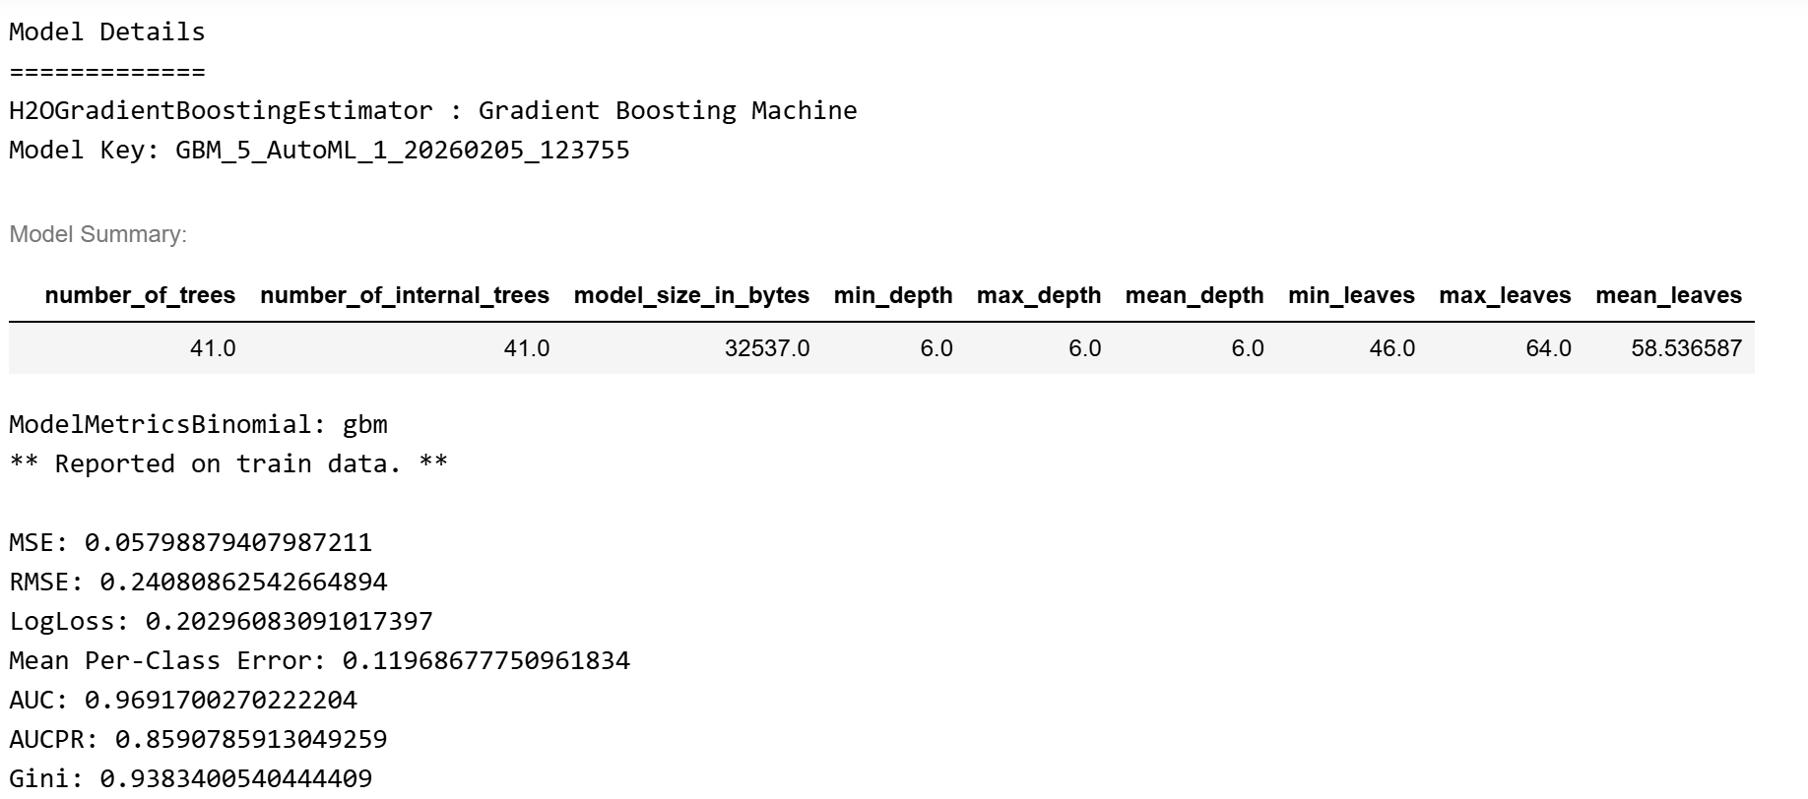
Leader Model
best_model = aml.leader
Top Performer
Returns the highest-ranked model from leaderboard
Top Performer
Returns the highest-ranked model from leaderboard
Not Guaranteed Ensemble
Could be single model or ensemble
Performance-Based
Selection depends purely on metric scores

Slide 14
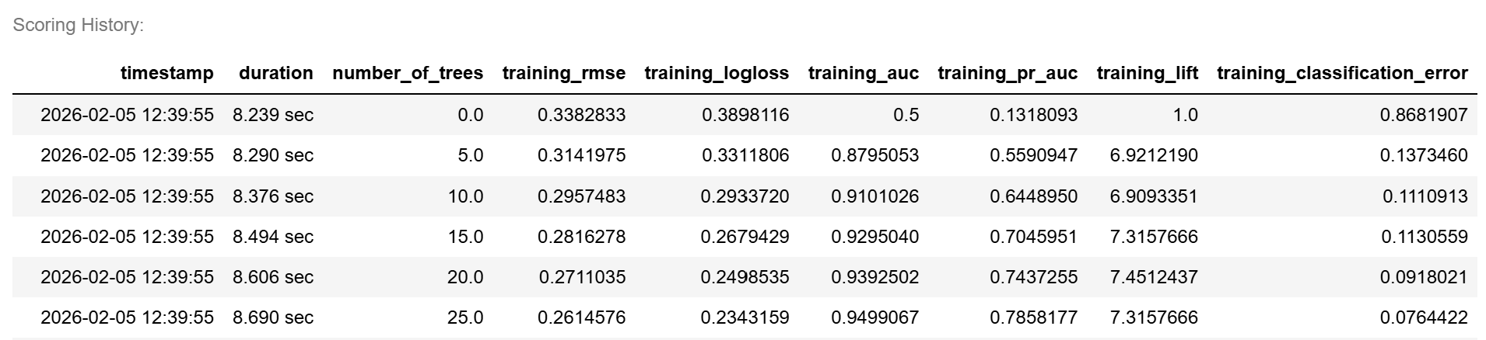
Scoring History of Single Model Leader
Tracks model learning progression over iterations
Top Performer
Returns the highest-ranked model from leaderboard
Learning Curve
Shows how metrics improve as trees increase
Detect Overfitting
Identifies when model memorizes training data
Performance-Based
Selection depends purely on metric scores

Slide 15
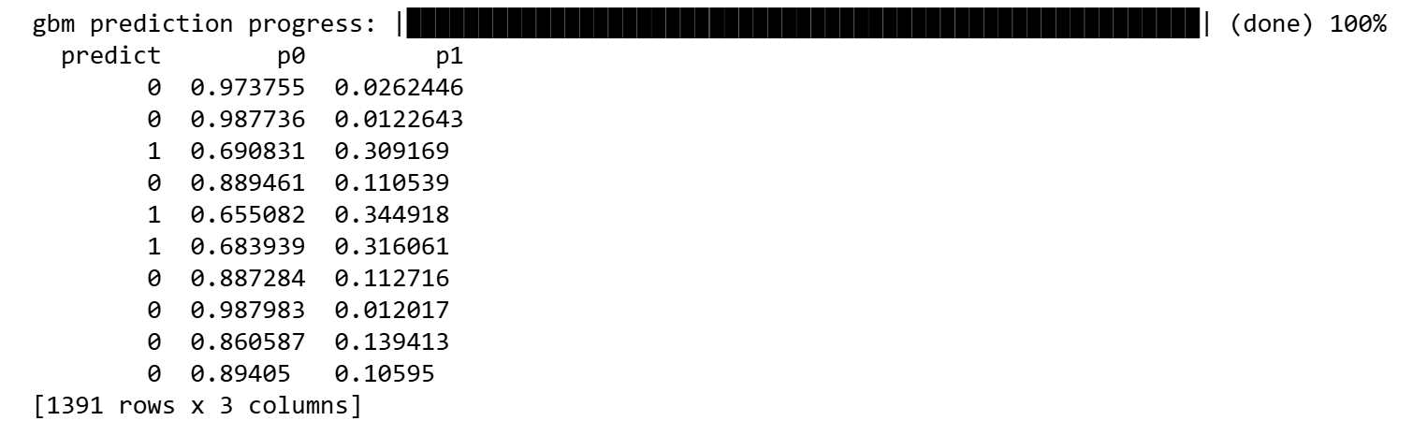
Making Predictions
pred = best_model.predict(test)
How It Works
Uses whichever model is the leader, whether single or ensemble
Same syntax regardless of model type
Output Format
Predicted class
Probability of each class

Slide 16
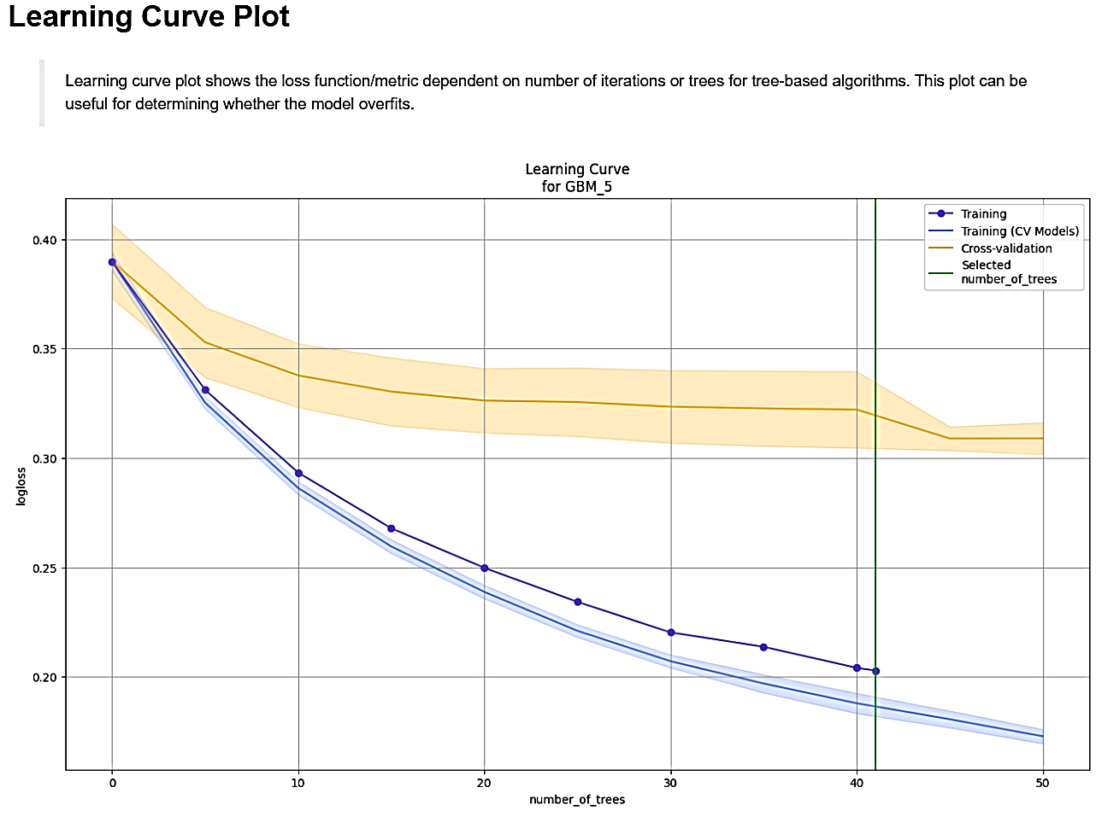
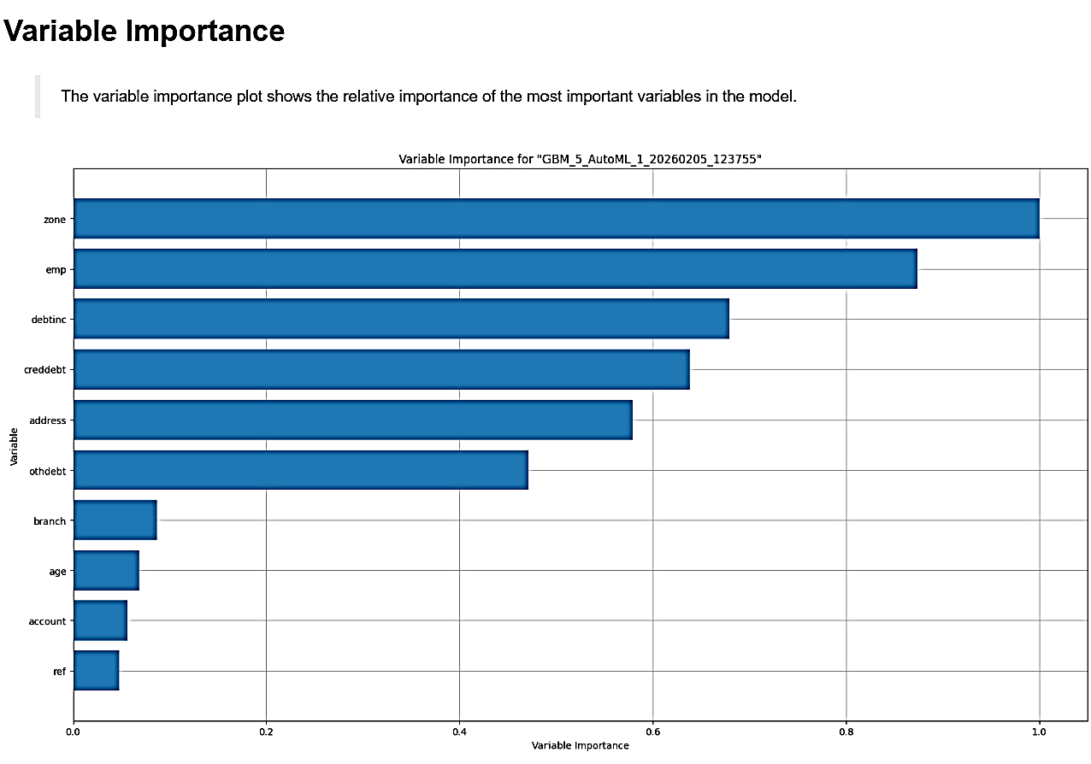
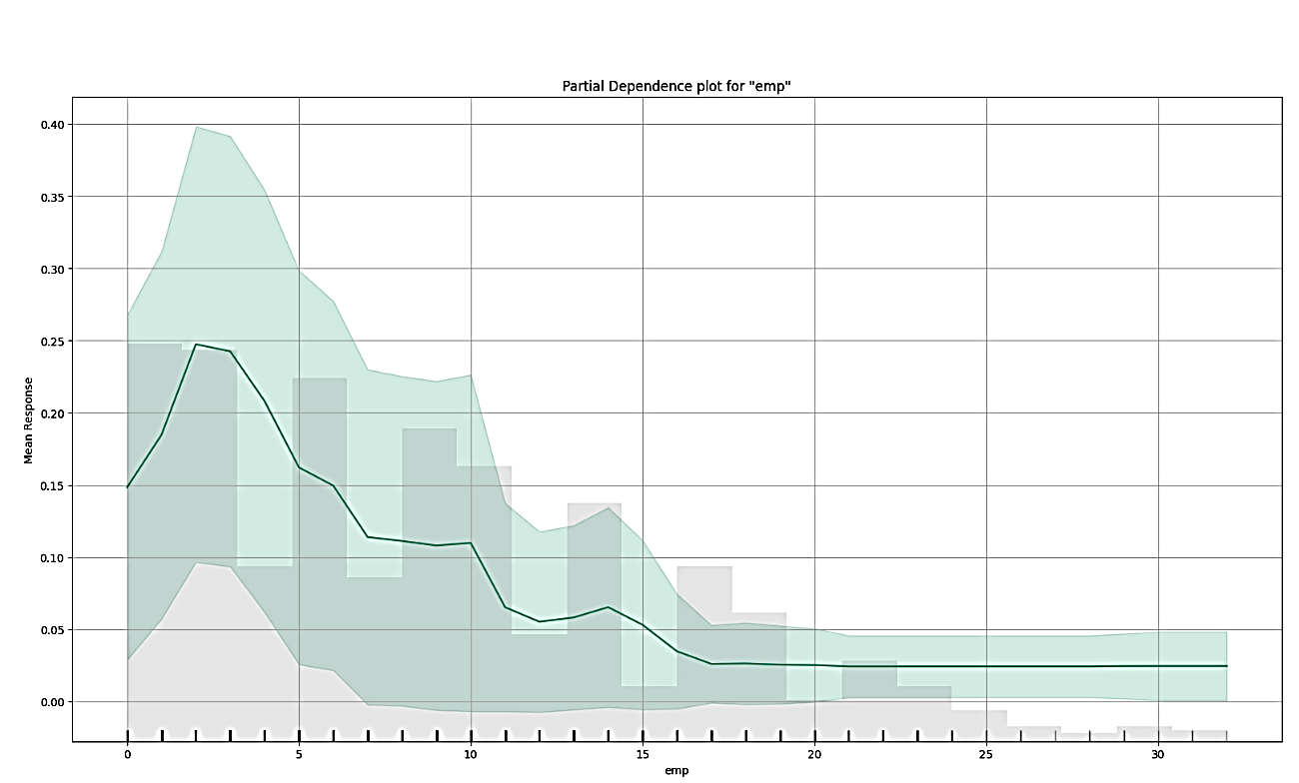
Model Explainability
best_model.explain(test)
Generates comprehensive interpretation outputs:
Feature Importance
Feature Importance
SHAP Summary Plot
Residual Analysis
Partial Dependence
Variable Interaction

Slide 17
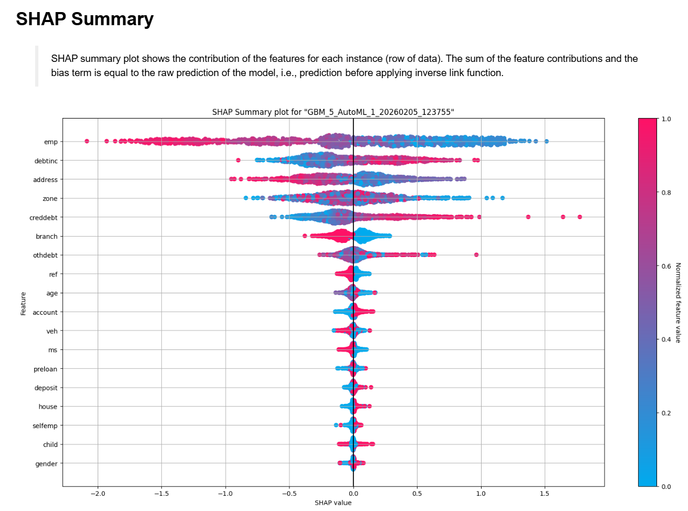
SHAP Summary Concept
  1. Feature Impact
  Shows how features affect predictions
2. Direction
Right = increases class 1 probability
Left = decreases probability
3. Color Coding
Red = high feature value
Blue = low feature value
4. Ranking
Top features are most influential

Slide 18
End-to-End Flow
01
02
03
Import Data
Convert to H2OFrame
Prepare Variables
Convert categorical variables
Split Data
Create train/test sets
04
05
06
Initialize AutoML
Set up H2OAutoML()
Train Models
Run automated training
Review Results
Check leaderboard
07
08
09
Get Leader
Extract best model
Predict
Generate predictions
Interpret
Explain and analyze

Slide 19
Key Takeaways
H2O AutoML transforms machine learning from a manual, time-intensive process into an automated, efficient workflow.
Accelerates development with automated training and tuning
Provides transparency through leaderboards and explainability
Suitable for both rapid prototyping and production baselines

